Slide 1
SQL QUERIES FOR HOTEL RESERVATION PROJECT
Atumonye James Chukwuemeka
MIP DA 08

Slide 2
1.SELECT COUNT(*) AS total_reservations FROM hotel_reservations
2. SELECT type_of_meal_plan, COUNT(*) AS num_reservations FROM hotel_reservations GROUP BY type_of_meal_plan ORDER BY num_reservations DESC

Slide 3
--Number of reservations made for a specific year
SELECT COUNT(*) AS reservations_in_year
FROM hoteldata
WHERE TRY_CONVERT(DATE, arrival_date) IS NOT NULL
AND YEAR(TRY_CONVERT(DATE, arrival_date)) = 2017;

Slide 4
--Average price per room for reservations involving children
SELECT AVG(avg_price_per_room) AS avg_price_with_children
FROM ..hoteldata
WHERE no_of_children > 0;

Slide 5
--Most commonly booked room type:
SELECT room_type_reserved, COUNT(*) AS num_reservations
FROM hoteldata
GROUP BY room_type_reserved
ORDER BY num_reservations DESC

Slide 6
--Number of reservations falling on a weekend
SELECT COUNT(*) AS weekend_reservations
FROM hoteldata
WHERE no_of_weekend_nights > 0;

Slide 7
--Highest and lowest lead time for reservations
SELECT MAX(lead_time) AS highest_lead_time, MIN(lead_time) AS lowest_lead_time
FROM hoteldata;

Slide 8
--Most common market segment type
SELECT market_segment_type, COUNT(*) AS num_reservations
FROM hoteldata
GROUP BY market_segment_type
ORDER BY num_reservations DESC

Slide 9
--Number of reservations with a booking status of "Confirmed":
SELECT COUNT(*) AS confirmed_reservations
FROM hoteldata
WHERE booking_status = 'not_canceled';

Slide 10
--Total number of adults and children across all reservations
SELECT SUM(no_of_adults) AS total_adults, SUM(no_of_children) AS total_children
FROM hoteldata;

Slide 11
--Average number of weekend nights for reservations involving children
SELECT AVG(no_of_weekend_nights) AS avg_weekend_nights_with_children
FROM hoteldata
WHERE no_of_children > 0;

Slide 12
--Number of reservations made in each month of the year
-- Number of reservations made in each month of the year
SELECT MONTH(TRY_CONVERT(DATE, arrival_date)) AS month, COUNT(*) AS num_reservations
FROM hoteldata
WHERE TRY_CONVERT(DATE, arrival_date) IS NOT NULL
GROUP BY MONTH(TRY_CONVERT(DATE, arrival_date));

Slide 13
--Average number of nights spent by guests for each room type
SELECT room_type_reserved, AVG(no_of_weekend_nights + no_of_week_nights) AS avg_nights
FROM hoteldata
GROUP BY room_type_reserved;

Slide 14
--Most common room type and average price for reservations involving children
SELECT room_type_reserved, AVG(avg_price_per_room) AS avg_price
FROM hoteldata
WHERE no_of_children > 0
GROUP BY room_type_reserved
ORDER BY COUNT(*) DESC

Slide 15
--Market segment type generating the highest average price per room
SELECT market_segment_type, AVG(avg_price_per_room) AS avg_price_per_room
FROM hoteldata
GROUP BY market_segment_type
ORDER BY avg_price_per_room DESC

Slide 16
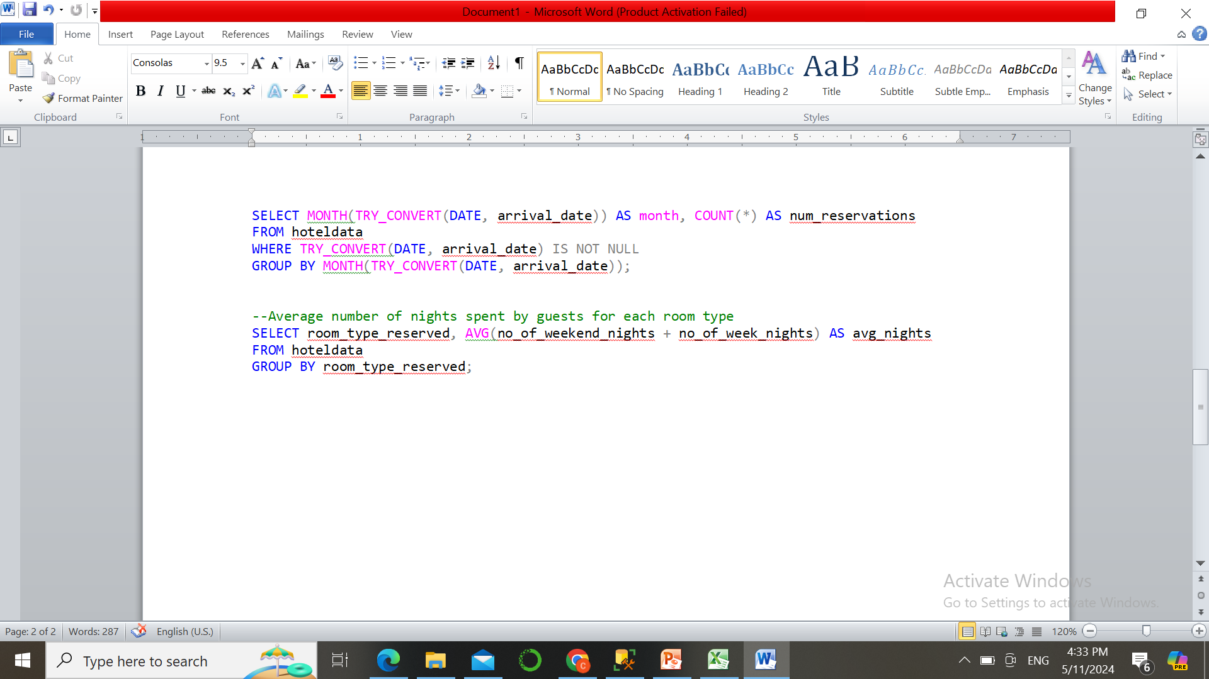

Slide 17
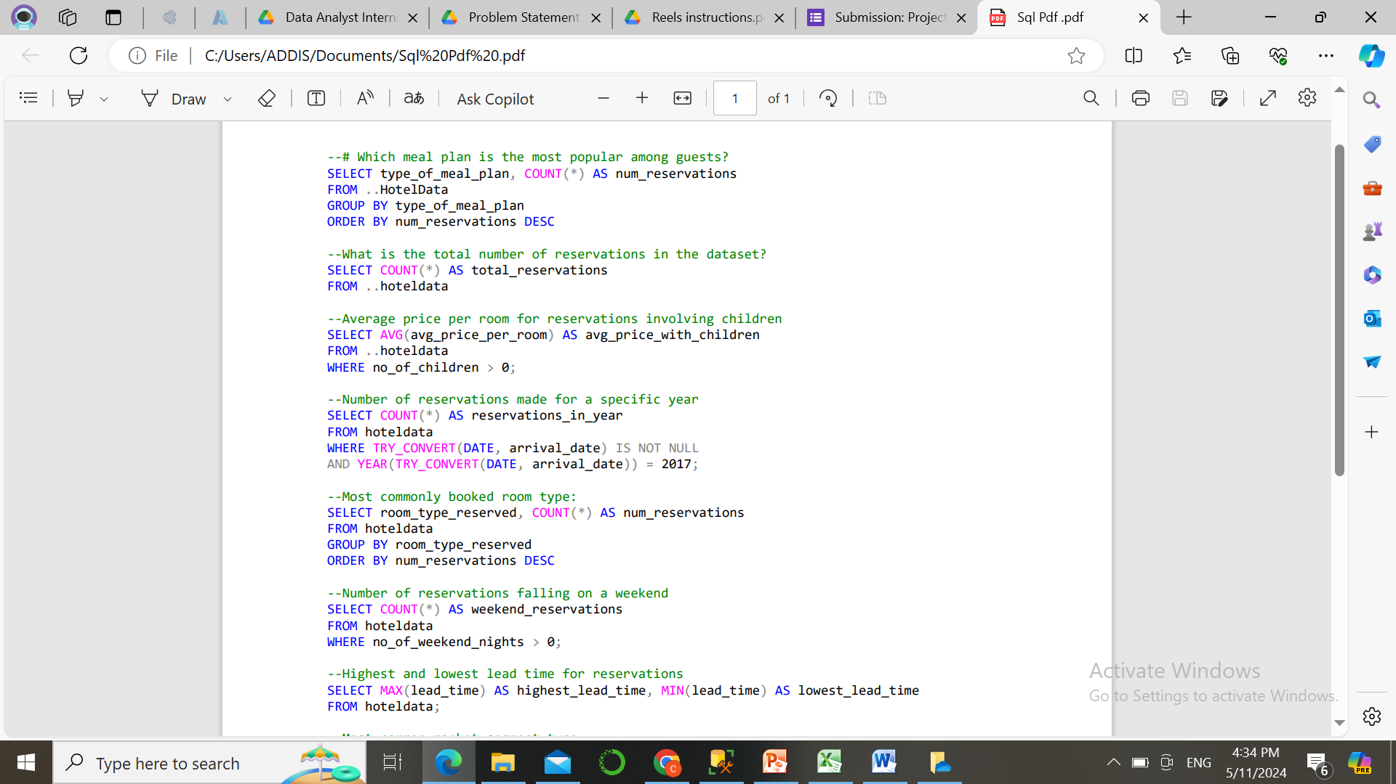

Slide 18
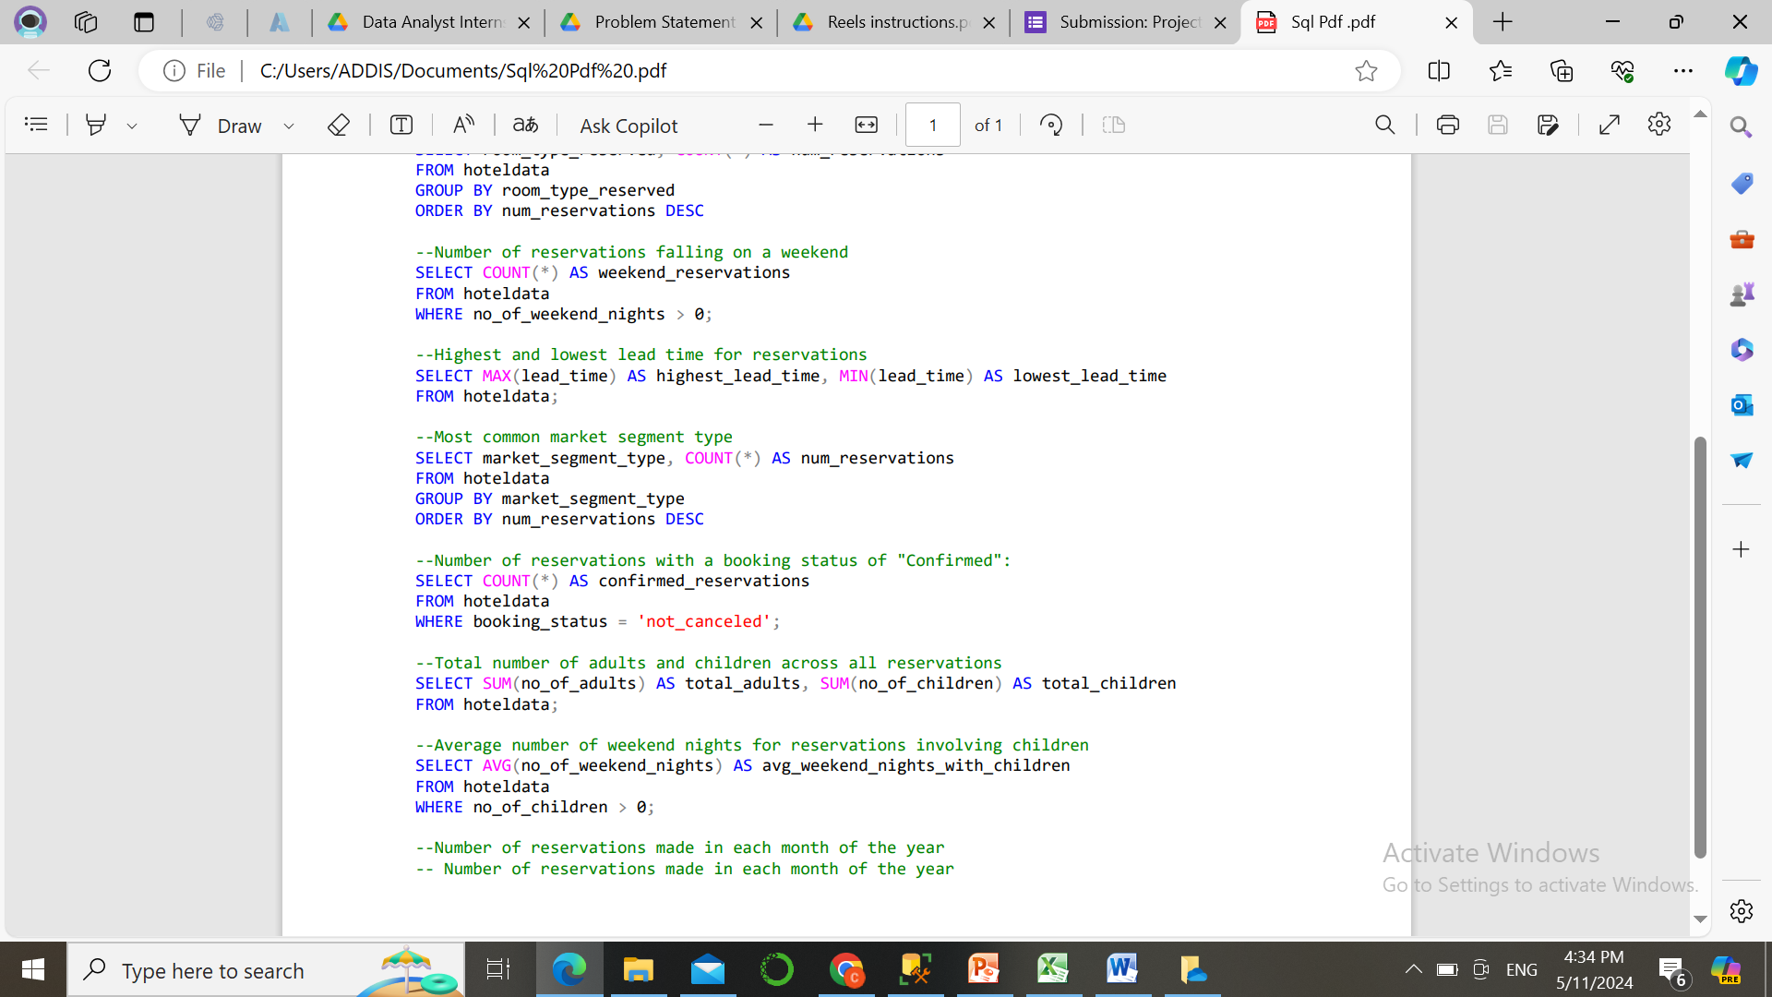

Slide 19
THE END
THANK YOU.

